Slide 1

FTD Project 2: Machine Learning Models
Therin Watson
Francois Jack
Nelson Ajayi
Ashfaque Rahman

Slide 2

Introduction: What is a fail to deliver?
A fail to deliver is a mistake. A fail-to-deliver (FTD) primarily occurs when an options contract becomes In-The-Money (ITM), and shares of the security in question are now obligated to be purchased and delivered as per the contracts terms.
Large financial entities, primarily Market Makers and Broker Dealers, who write and create options contracts to be sold to traders, are the entities who create FTDs by neglecting or failing to purchase shares of a security before their required settlement date.
When a contract is processed or fulfilled, but the shares are not located on the market, an FTD is posted equal to the number of shares not located.
This fail is then reported to and recorded by FINRA and the SEC. The SEC posts all market fail-to-deliver data on their website every 15 days, for all equities trading on US markets.
FINRA is the entity in charge of making sure the FTD obligations are eventually purchased and fulfilled, as well as levying fines and other “punishments” for failing to settle securities in a timely manner

Slide 3

Summary of Project 1
Meme stocks (GME, AMC, etc.), while relevant and posting more FTDs than the average equity, are not the securities posting the most FTDs on US markets
63 different symbols all posted more FTDs relative to the amounts GME posted
73 of the top 100 symbols for FTD data were ETFs as opposed to single companies
Conclusion: FTDs occur way more often on the stock market than previously assumed, with many symbols posting absurd amounts of fails, indicating many of their shares were never purchased within their expected settlement dates, if ever purchased

Slide 4

Hypothesis
This project makes several assumptions
It assumes that, from a brokerage or other large financial entity’s position, it can be better to fail on an obligation than it is to cover or fulfill the obligation
This is especially true if the fines and other punishments for failing to deliver and locate shares of a security, are cheaper than the cost of locating the shares themselves. Especially in instances where a company’s stock has high amounts of short interest attached to the security
When a FTD is posted, it creates an obligation of shares needed to be purchased on the market. While a buy/sell order was processed and money may have moved to its intended recipients, the underlying shares of the company were never purchased, but are still required to be purchased as per the market rules dictated by FINRA, SEC, and other regulatory authorities

Slide 5

Hypothesis
Assuming Fail-to-Delivers are guaranteed to be eventual “buys” of a security, can a machine learning model be created that can predict closing price movement of a security, by examining features of a stock’s price, including Fail-to-Deliver and Short Interest data?
Therefore, the goal of this project is to locate as many equities as possible with high quantities of FTDs, collect, and use the historical data of the security as features for the machine learning model, in order to create a suite of models that can accurately predict the closing price of the securities collected and passed through the models
Once the best and most accurate models are created: they can be used to create an investment portfolio of stock symbols where Fail-to-Deliver and Short Interest data can be used to predict when to buy and sell these securities
Market makers are often less concerned with the fundamentals of a stock and more concerned with being able to turn over positions. By being far more active in terms of volume and number of transactions, they may use a stock price’s rapid fluctuations to make a profit. They focus more on chart patterns indicating price trends. Thus, appropriate Technical Indicators should be able to understand, the movement in stocks that have posted an FTD, as the market maker is guaranteed to seek the best price, whether highest for a sale or lowest for a buy.

Slide 6
Data Collection
Sources of data used
SEC for Fail-to-Deliver Data
https://www.sec.gov/data/foiadocsfailsdatahtm
FMP API for Historical Stock Data
https://fmpcloud.io/documentation#historicalStockData
FINRA for Short-Interest Data, through the NASDAQ/QUANDL API
https://data.nasdaq.com/data/FINRA-financial-industry-regulatory-authority
IEX API for any additional data or information FMP could not provide
https://iexcloud.io/docs/api/

Slide 7
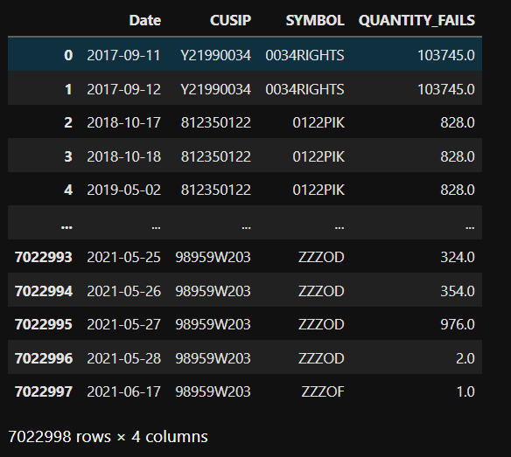
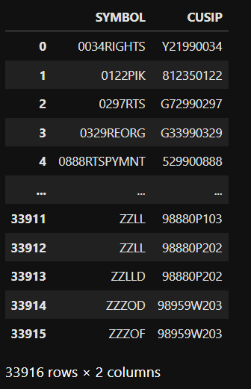
Collected Data – SEC
FTD Data: 7 million entries
Symbol List: 33,000+ Symbols

Slide 8
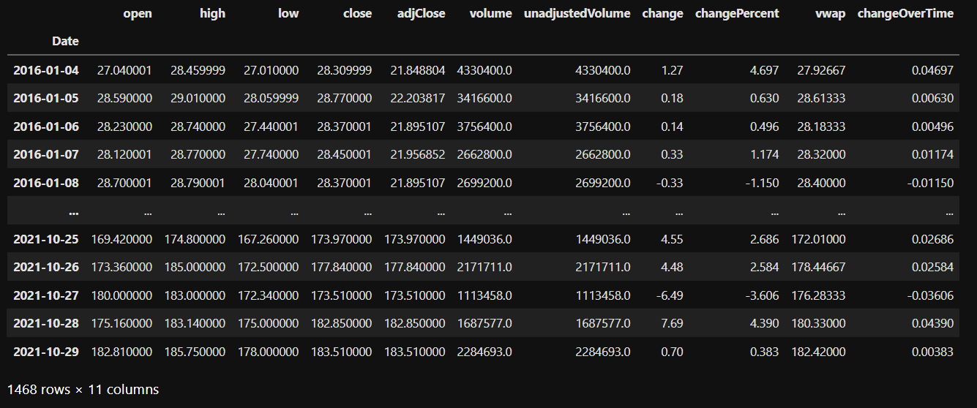
Collected Data – FMP

Slide 9
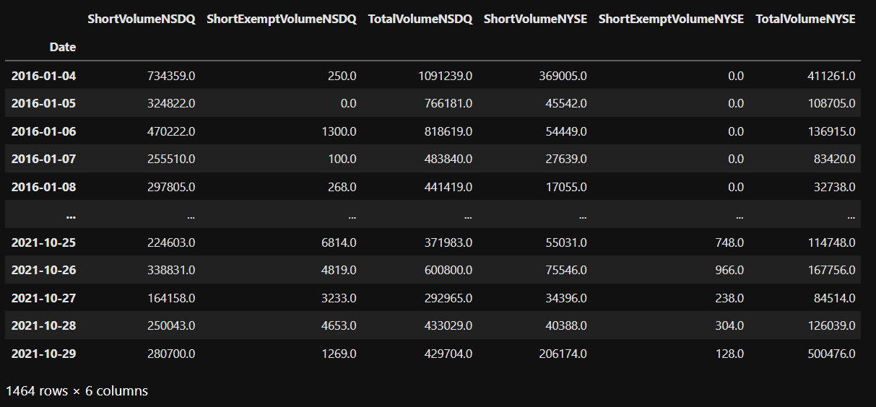
Collected Data – FINRA

Slide 10
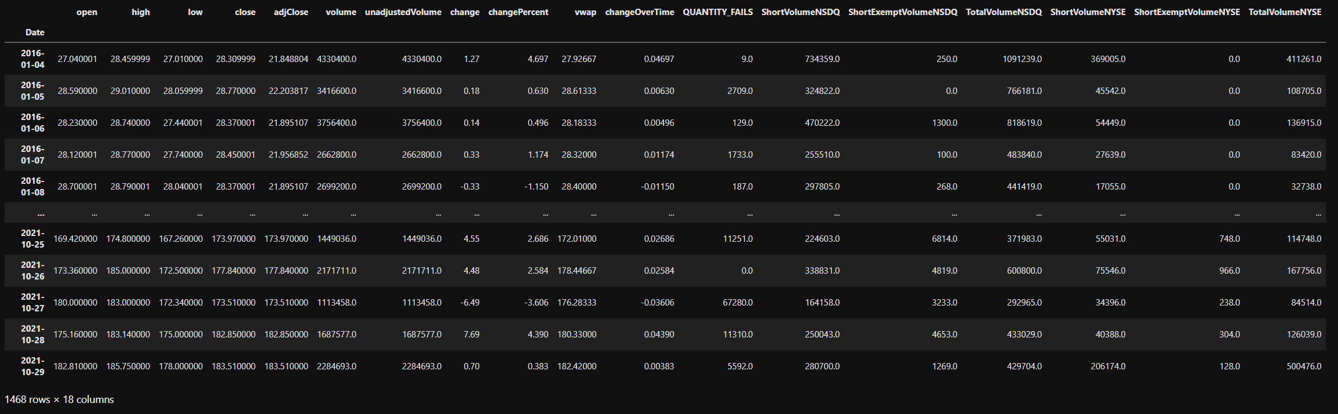
Time Series DataFrame Example

Slide 11
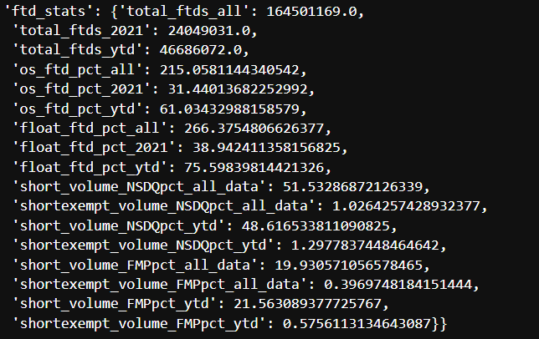
Collected Data – IEX
After collecting FTD and Historical Data for over 12,000 symbols successfully, it was necessary to find stocks with relevant FTD statistics and cut down on our list of symbols to run through the models.
Using FMP and IEX, we could locate both Float and Outstanding Shares data, and calculate the percentage of shares which failed-to-deliver over a given time frame, and then only use symbols with the highest percentages of FTDs.
This process cut down our list of viable symbols down to 3700 as sourcing both Float and Outstanding Share data was quite difficult
Additionally, we could then compare Short Interest data to find the stocks with the highest numbers of shares sold short as well
Using GME as an example:
75.6% of its float has failed-to-deliver in the past year
48.61% of all volume on the NASDAQ and NYSE is due to short-sales in the past year, according to FINRAs own data

Slide 12
Post-Data Collection: Adding Technical Indicators
In order to improve our feature set going into our machine learning models, we decided to calculate and append technical indicators to our DataFrames.
Using https://school.stockcharts.com/doku.php?id=technical_indicators , the indicators we chose are:
Bollinger Bands: A chart overlay that shows the upper and lower limits of 'normal' price movements based on the Standard Deviation of prices.
Double Exponential Moving Average (DEMA): A faster moving average calculation that offsets values in order to reduce the traditional lag found in moving averages.
Accumulation/Distribution Line (ADL): Combines price and volume to show how money may be flowing into or out of a stock.
Relative Strength Index (RSI): Shows how strongly a stock is moving in its current direction.

Slide 13
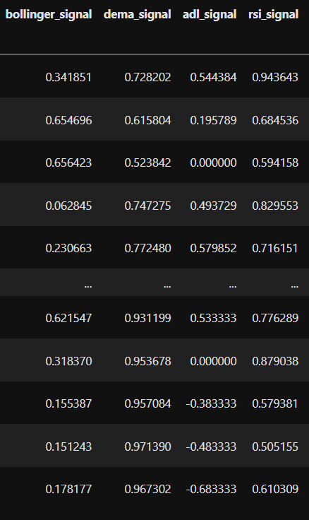
Post-Data Collection: Adding Technical Indicators
By calculating and adding these indicators onto our data, we can provide our model with 4 extra features directly relating to daily price movement
These indicators can also be used after the model to aid in deciding the best times to either buy or sell any given security

Slide 14
Deciding on what Symbols to use for Machine Learning
At this point, roughly 3700 symbols had successfully run through both API data gathering, and technical indicator calculations. However, this is too many symbols to run Machine Learning Models on in the given timeframe, so it was necessary to reduce this count.
Two metrics are to be used to slice down this list of data:
Quantity of FTDs Recorded (YTD) /
Float Shares (or Outstanding Shares if ETF)
Total Short Volume (YTD) /
Total NSDQ+NYSE Volume
Basically – we want the stocks with the most FTDs, and with the highest short interest, based off data from the past year (Oct 2020 to Oct 2021).

Slide 15
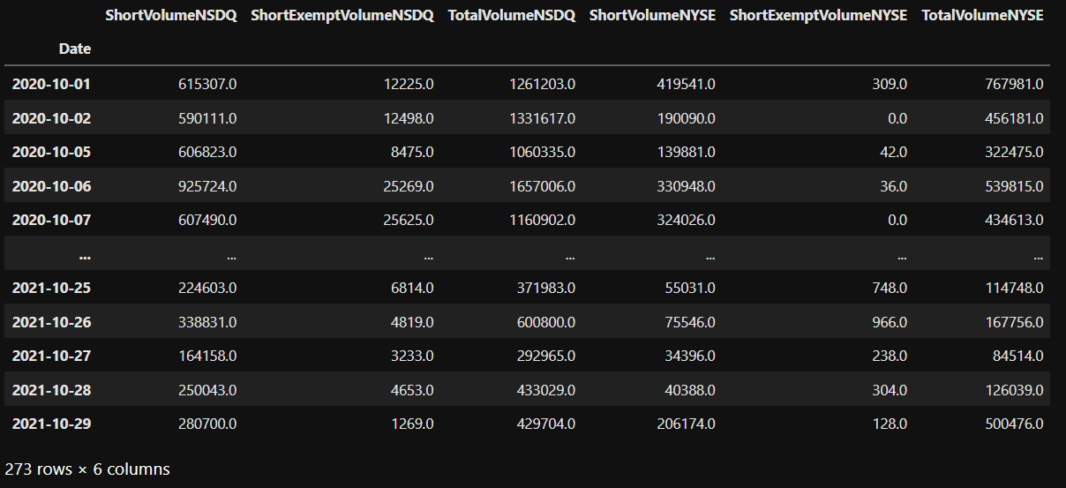
YTD Short Interest Calculation Example
FINRA Dataset includes 6 columns
Three from the NASDAQ, and three from the NYSE.
Short Exempt Volume, while interesting, is being disregarded for the calculation
By totaling the Short Volume for both NSDQ and NYSE, as well as the Total Volume columns for the two exchanges, you can then divide Total Short Volume by Total Volume, and gain a “YTD Short Interest” percentage value that can be used to compare different securities to each other

Slide 16
Deciding on what Symbols to use for Machine Learning
After sorting symbols which have posted FTDs totaling 5% or more of their Float/Outstanding Shares
932 stocks remained.
Out of the 932 symbols, 930 symbols had a “YTD Short Interest” of 20% or higher. Therefore, we need an even higher Short Interest metric
AMC has a YTD Short Interest of 43.94%
672 Symbols (including AMC) have a YTD Short Interest of 43% or higher.
GME has a YTD Short Interest of 48.62%
379 Symbols (including GME) have a YTD Short Interest of 48% or higher.
Therefore, we will use 379 symbols and their data to create 379 machine learning models.

Slide 17

Machine Learning Models: To Lag, or Not To Lag?
After deciding on the model, two versions of the dataset were to be used with the model in order to determine which would create the best model
By lagging the dataset by 15 days relative to the close, could that create a more predicative model that a dataset which is current to the model?
15 days was chosen because that’s the span by which the SEC releases its data. However, 2 days, 21 days, and 35 days, could all be appropriate time frames by which to lag data, due to the rules involved with settlement of stock shares.
But due to the time constraints of running the models, only 15 days was used for lagging the data, alongside the normal dataset.

Slide 18
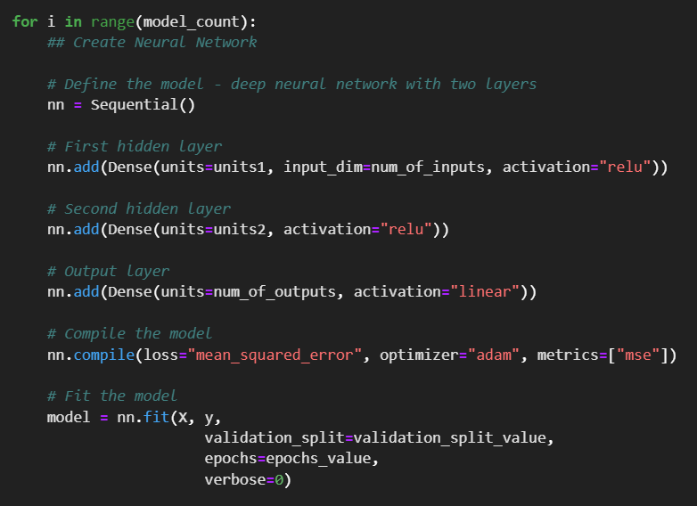
Machine Learning Models
For each symbol, a model was created using a Deep Neural Network comprised of two layers
20 features were provided to the model in order to predict one column of outputs
Validation was split on a 0.3 ratio which consistently provided best results
This setup provided the best results in the time available to run the models. Each symbol was iterated through 5 variations of the model, with the most accurate model presenting the least loss saved at the end of the loop.
Other types of models were explored and researched, but due to the nature of the time series data being used, a Dense Deep-Learning Neural Network appeared to be the best model, as well as the model that gave the most accurate results

Slide 19
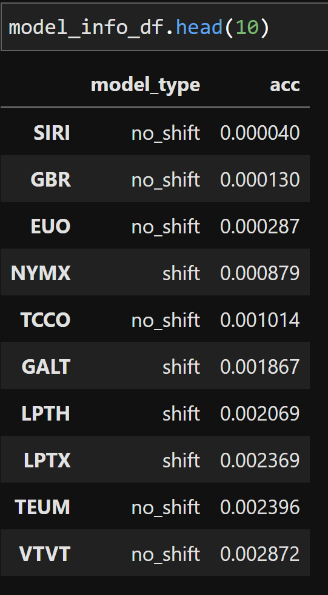
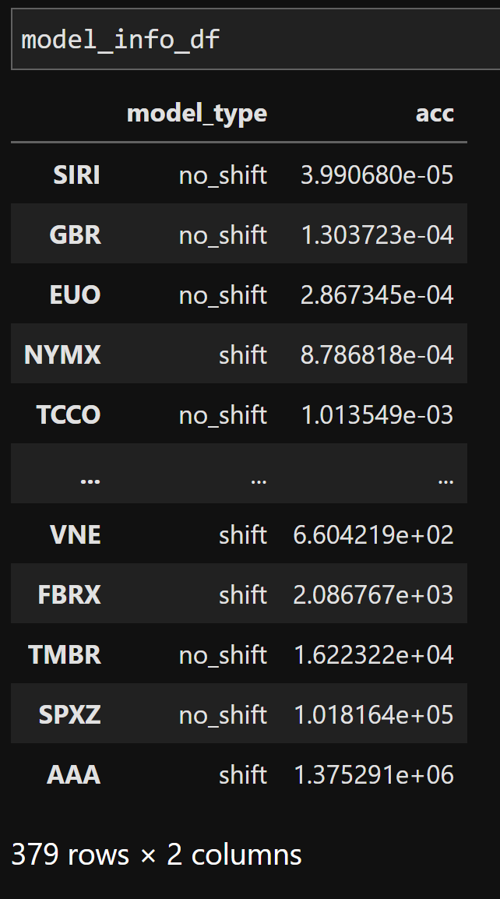
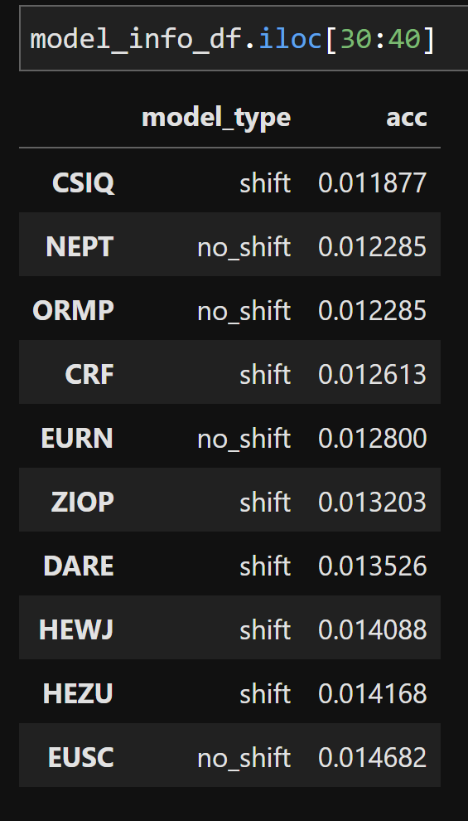
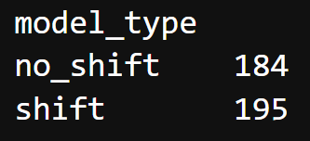
Machine Learning Evaluations
After deciding on the Deep Learning parameters for the model, we now had to run both sets of data (lagged and non-lagged) through the model, compile and save the best models.
Each set of data was run through 5 models each with the best results kept at the end of testing
Sorting the models by accuracy - the “best” models appeared too accurate and are likely overfitted. And the “worst” models basically did not perform at all
Therefore, the first and last 38 models were dropped from the list, and 304 models were evaluated going forward

Slide 20

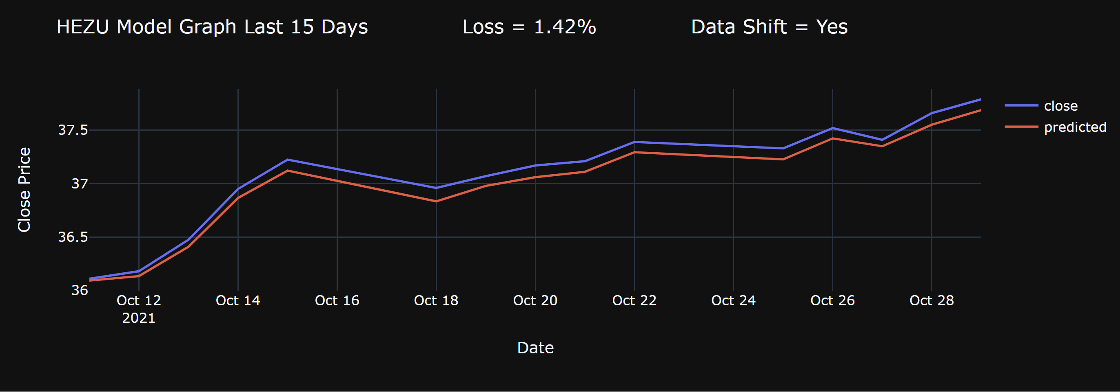
Machine Learning Validation Results

Slide 21
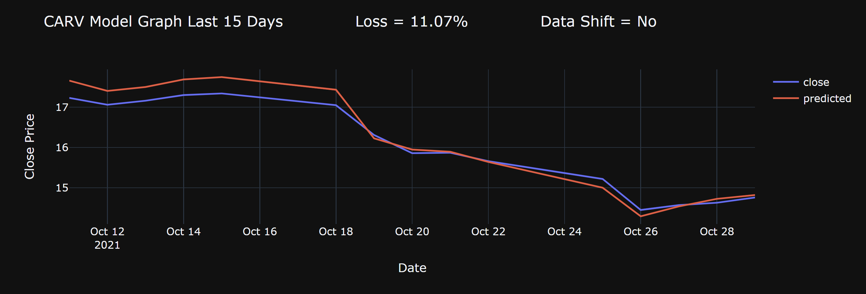
Machine Learning Validation Results

Slide 22
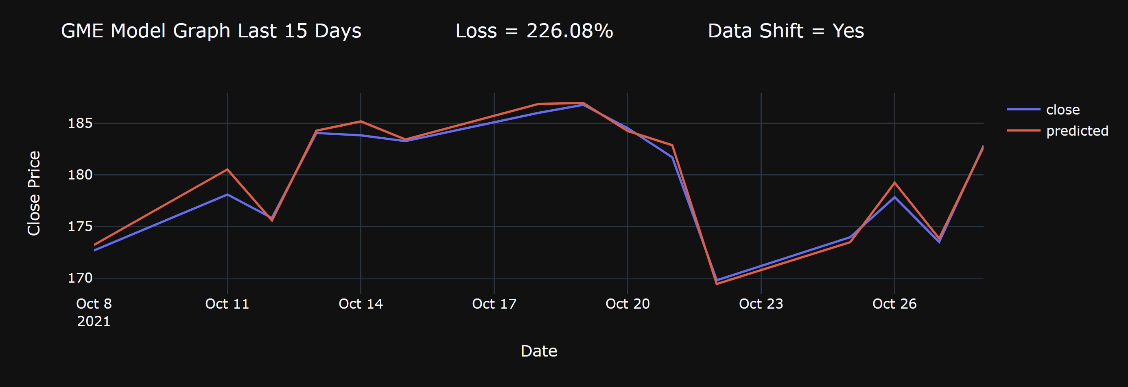
Machine Learning Validation Results

Slide 23
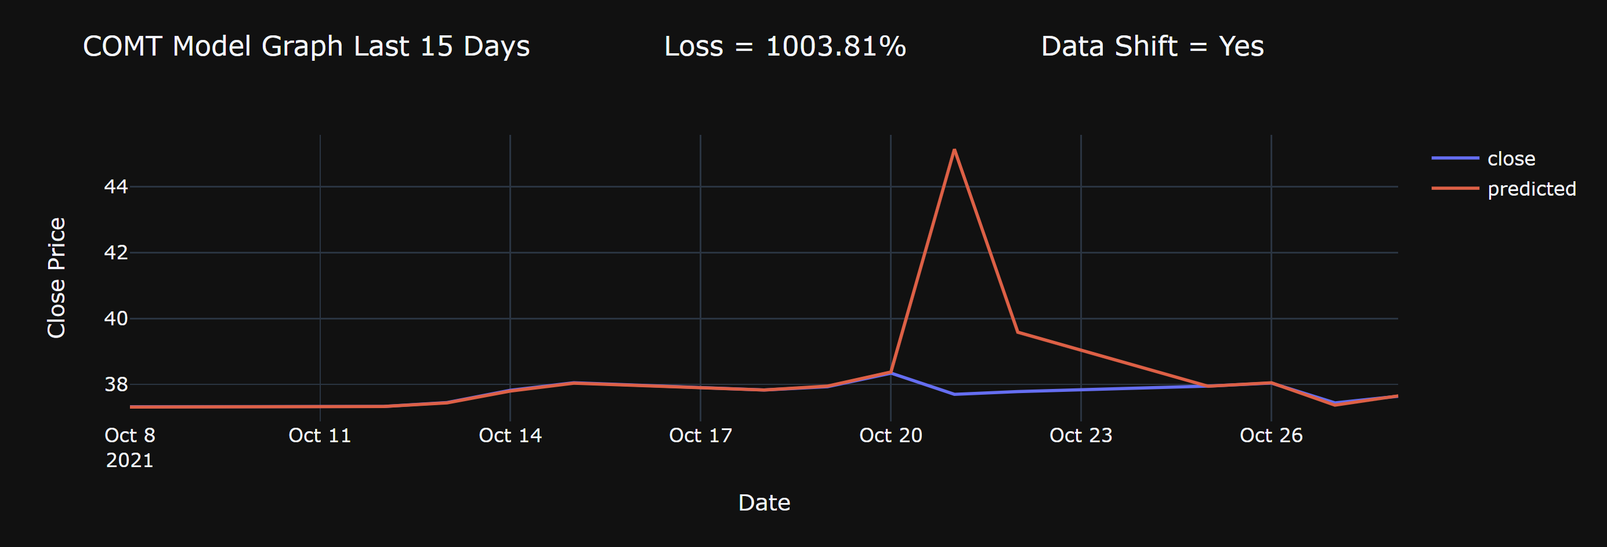
Machine Learning Validation Results

Slide 24

Testing Models with New Data
The dataset used to train, create, and validate the models runs from February 2016 until October 2021
Since starting the project – the first half of November 2021 FTD data is now available on the SECs website
By gathering this data and using our existing models, will our models still be able to predict accurately when we add new data to the model?

Slide 25

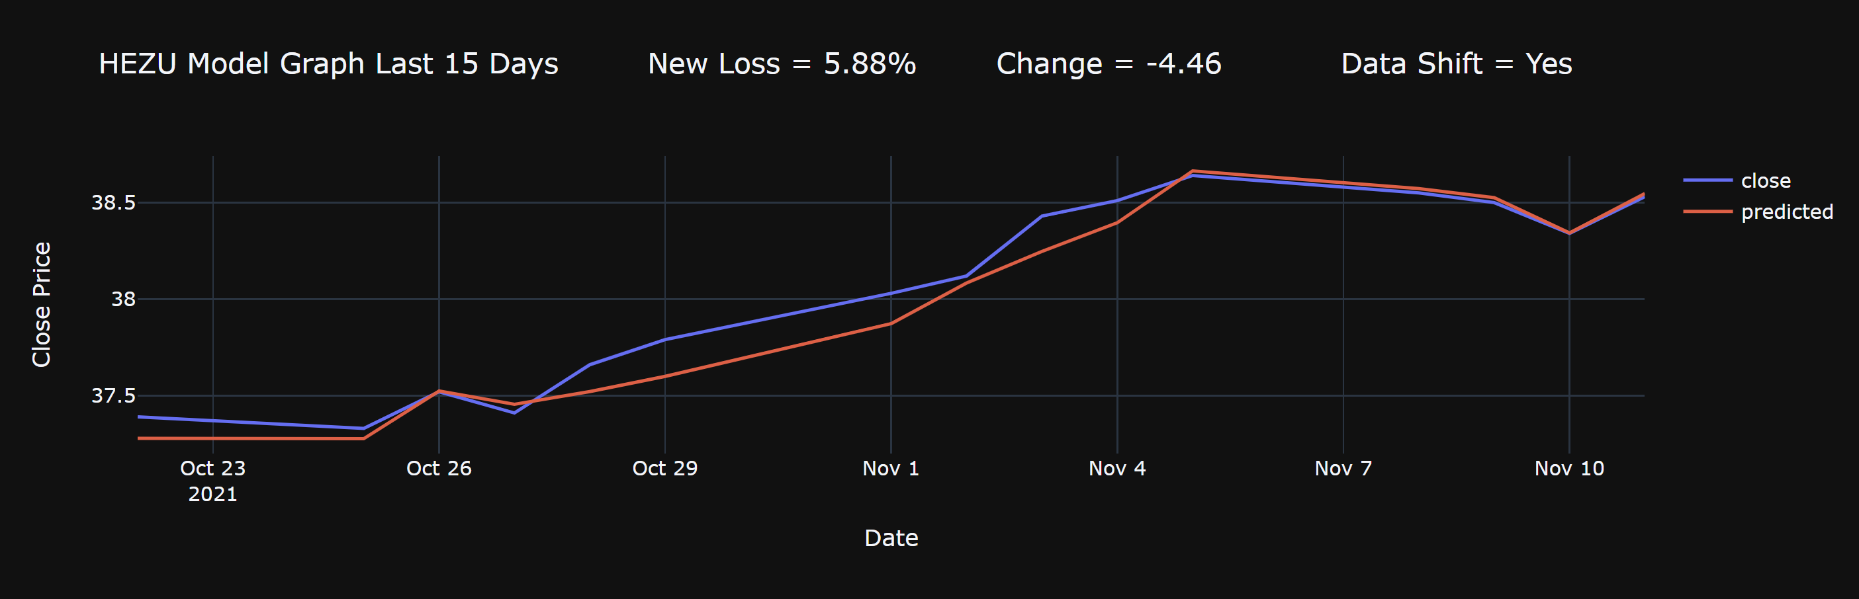
Testing Models with New Data

Slide 26
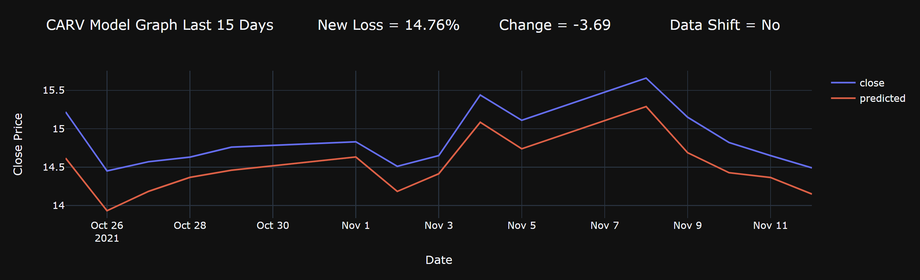
Testing Models with New Data

Slide 27
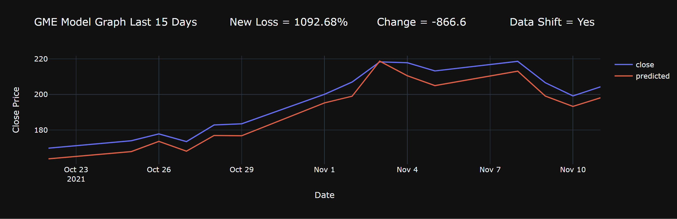
Testing Models with New Data

Slide 28
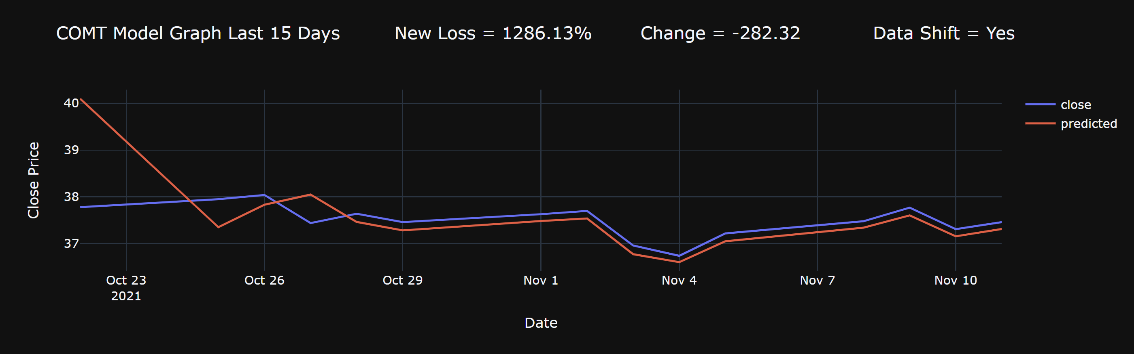
Testing Models with New Data

Slide 29

Testing Models with New Data

Slide 30
Testing Models with New Data

Slide 31
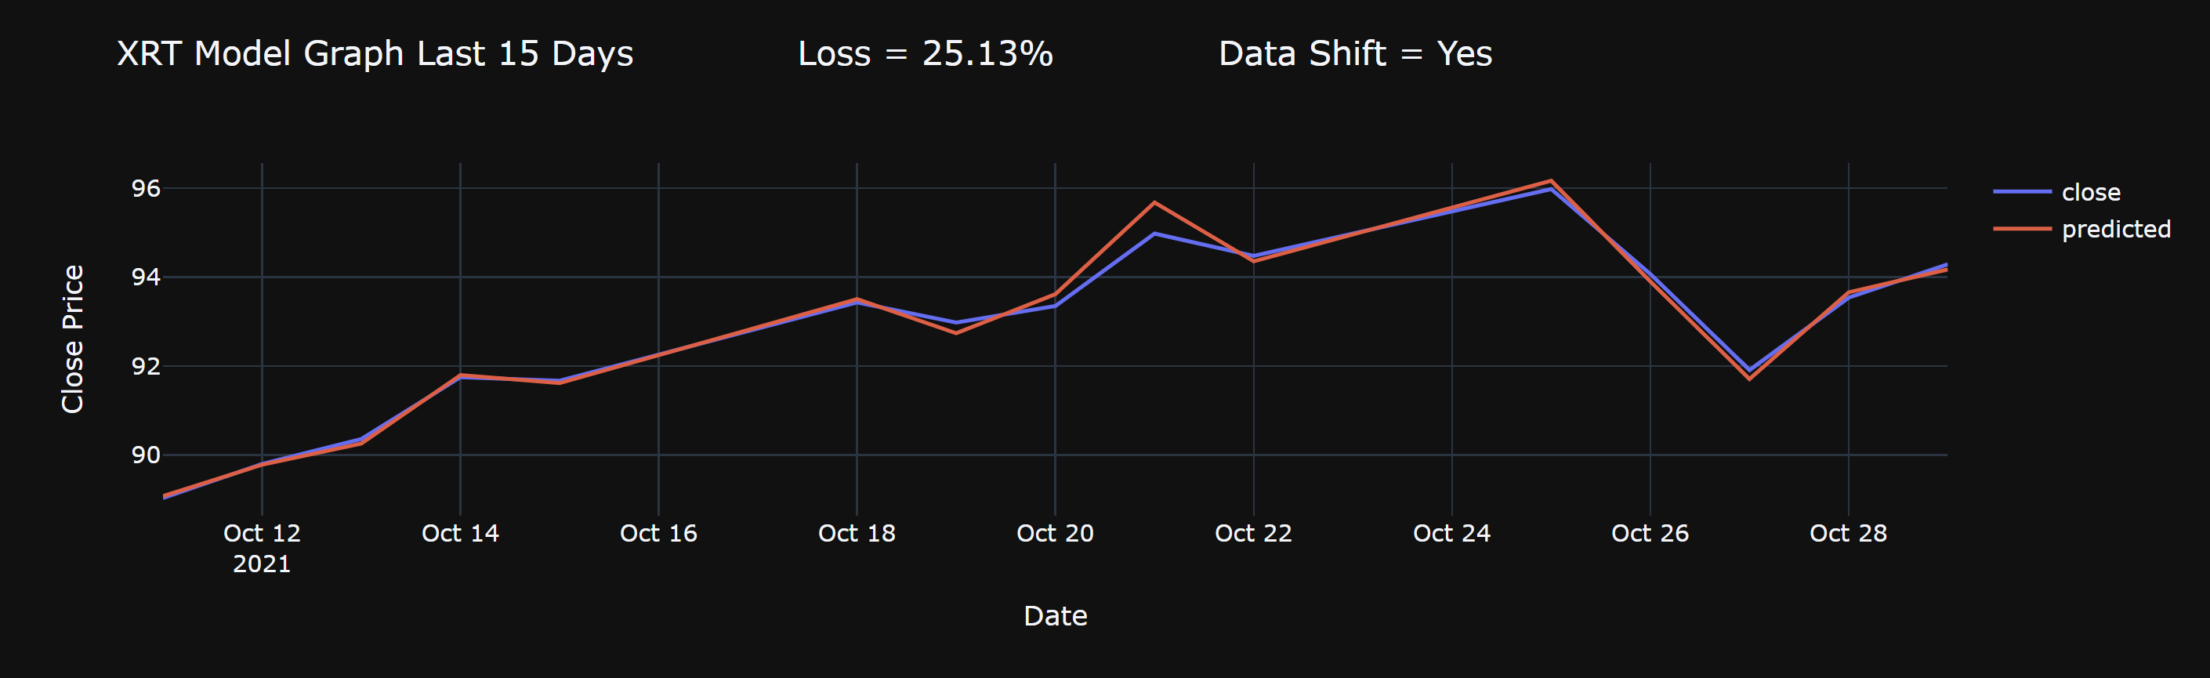
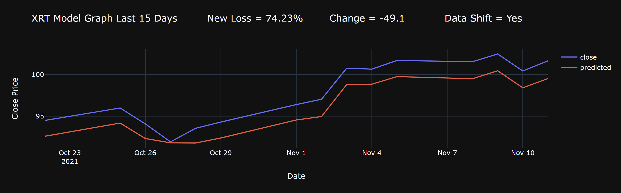
Testing Models with New Data

Slide 32

Fail-to-Deliver Project 2: Conclusions and Next Steps
Overall, the project was successful – models were generated which could accurately predict closing prices for their respective symbols given our created dataset
At the end of testing, 288 models were leftover which were able to accept new data for their respective stock symbols, and continue to generate accurate results
Lagging or not-lagging the features of the dataset by 15 days did not produce significantly for every symbol but did improve the overall accuracy of 50.8% of the models generated
This model uses a constrained amount of data due to the time available to prepare the project – it is likely even more models for more symbols could be created by expanding parameters by which stocks to test

Slide 33
Fail-to-Deliver Project 2: Conclusions and Next Steps
However, much of this model is still theoretical, and there are core issues to its usability as a model by which to trade on
Main issue is the delay by which the SEC updates their FTD data – all other features of the dataset can be found daily, and with the except of FTD data, could be used to make next-day predictions once daily-EOD data becomes available
The models themselves require more validation and testing. This includes testing more symbols, changing split size of test versus train data, adding more layers to the neural network, as well as experimenting more with the number of neurons per neural network

Slide 34
Fail-to-Deliver Project 2: Conclusions and Next Steps
How would you use this model to trade?
With 288 models:
Supplement the models with additional data and indicators for these symbols
Use the models to attempt to predict the best times to buy, sell, hold (and even short) the stock by calculating previous 15 days (or other timeframes) of returns data and attempting to predict the next window of price movement
All 288 symbols share two guaranteed things in common – high quantity of FTDs, and experience very high and regular amounts of Short activity and volume
Supplement the models alongside options predictions models, in attempts to predict high volatility periods when options contracts come due
Attempt to predict FTDs with another Machine Learning Model (LSTM possibly?), and re-use successful Deep Learning models alongside another machine learning model to forecast future price movement

Slide 35
Fail-to-Deliver Project 2: Conclusions and Next Steps
Is this model actually a short-interest model?
How important was the FTD data relative to the Short-Interest data? Or the daily price volume? Or last day’s close price?
With over 200 successful models – more research and breakdown needs to go into what is making these models so successful, and experimentation with removing, and adding features back
More examination of the failed models that did not predict data accurately

Slide 36

Final Thoughts?

Slide 37
End of Project
Please feel free to ask any questions

